Slide 1
OneAgent Deployment & Host Monitoring

Slide 2
What is OneAgent?
Dynatrace OneAgent is:
A single intelligent agent
Auto-discovers services
Collects infrastructure + application data
Enables full-stack observability

Slide 3
OneAgent Architecture Flow
OneAgent installed on host
Sends data to:
  Dynatrace SaaS (direct)
  Or via ActiveGate (optional)
  Data processed by AI Engine (Davis)

Slide 4
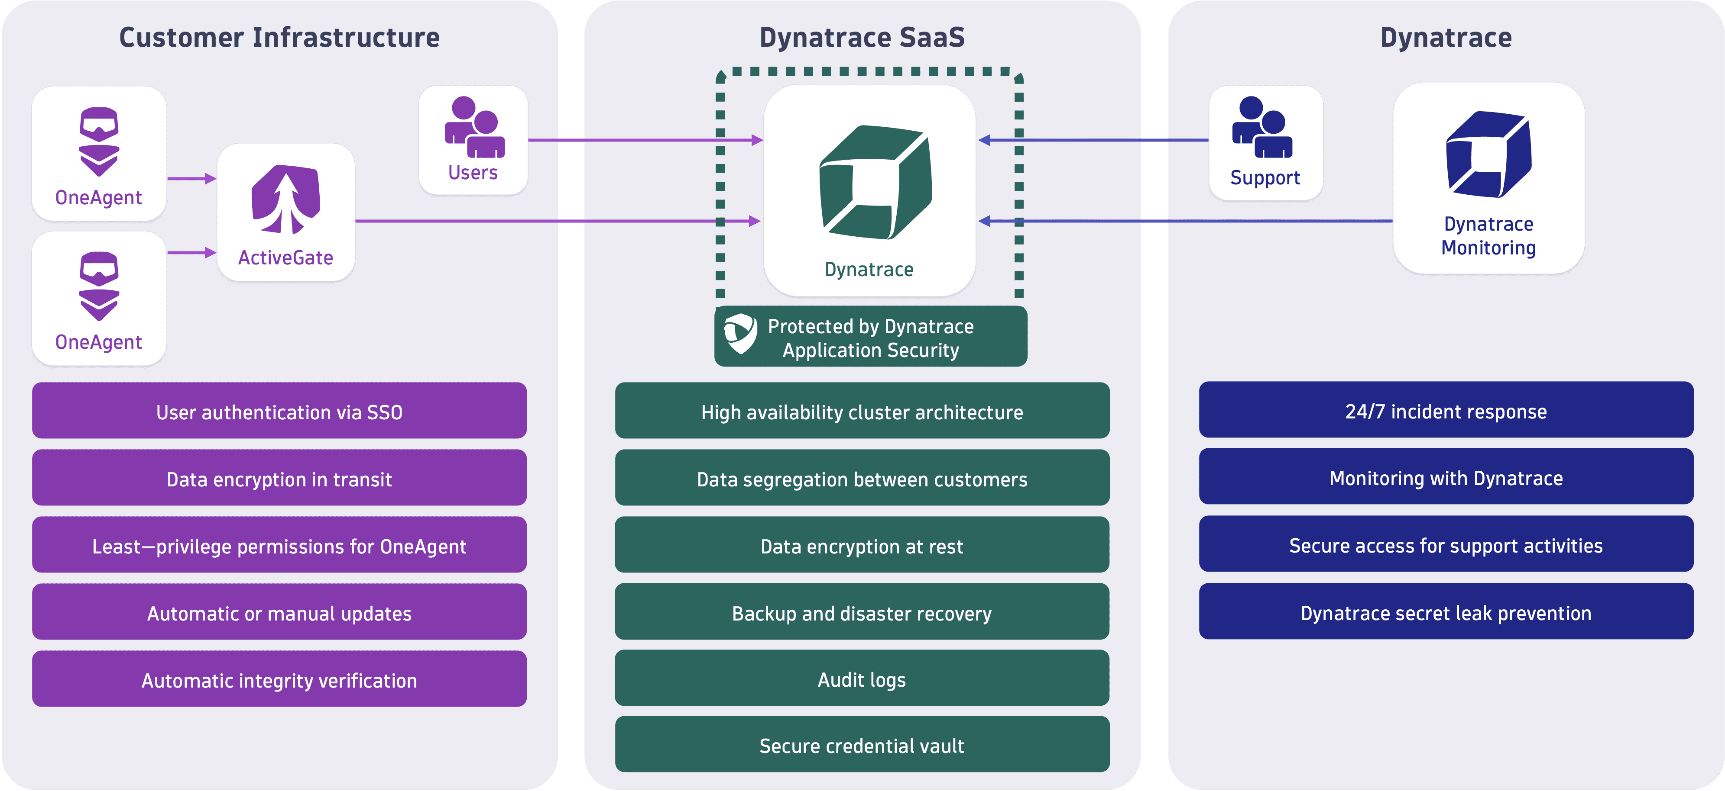

Slide 5
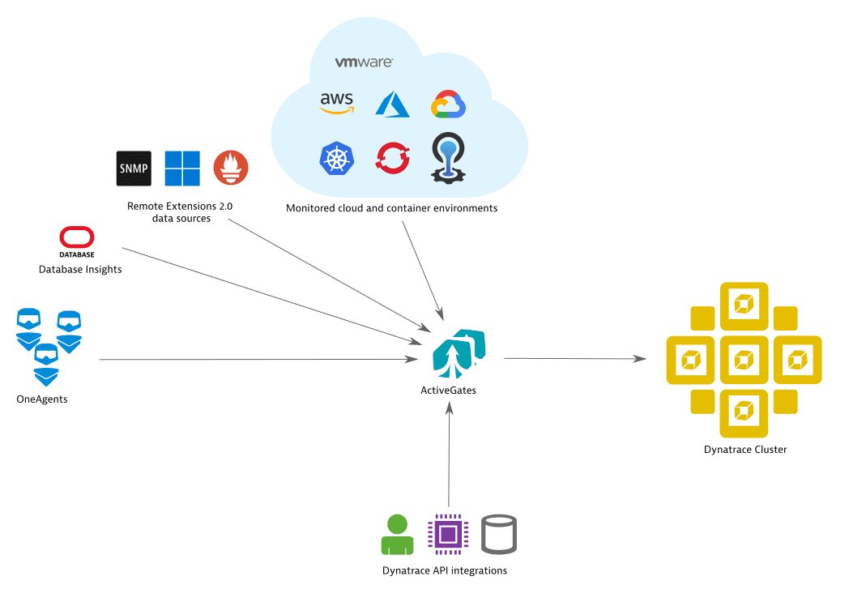

Slide 6
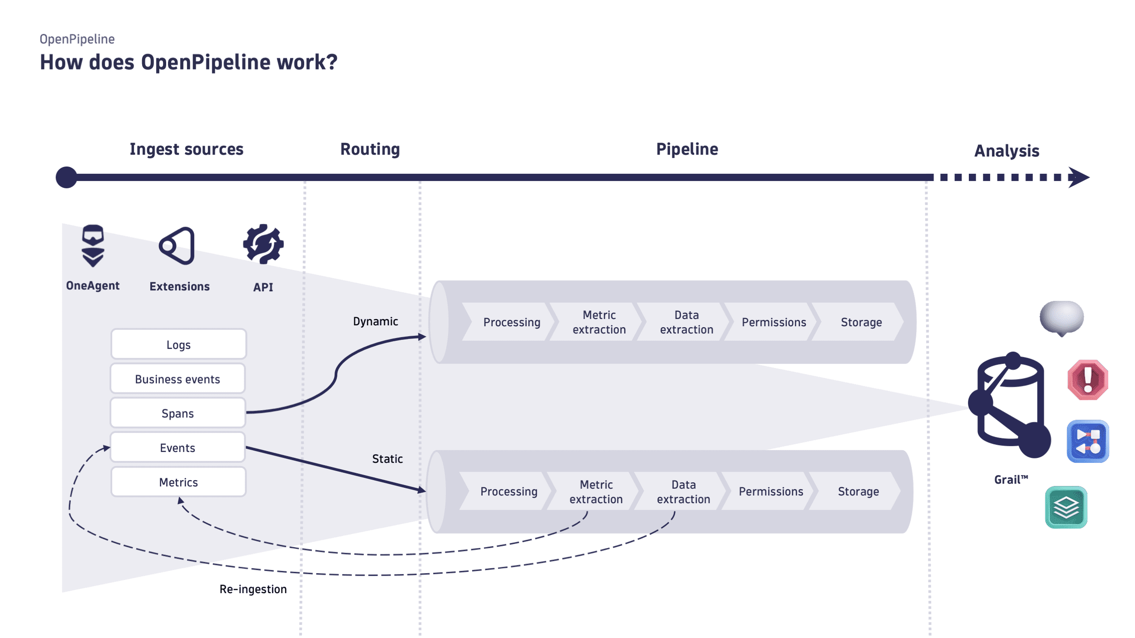

Slide 7
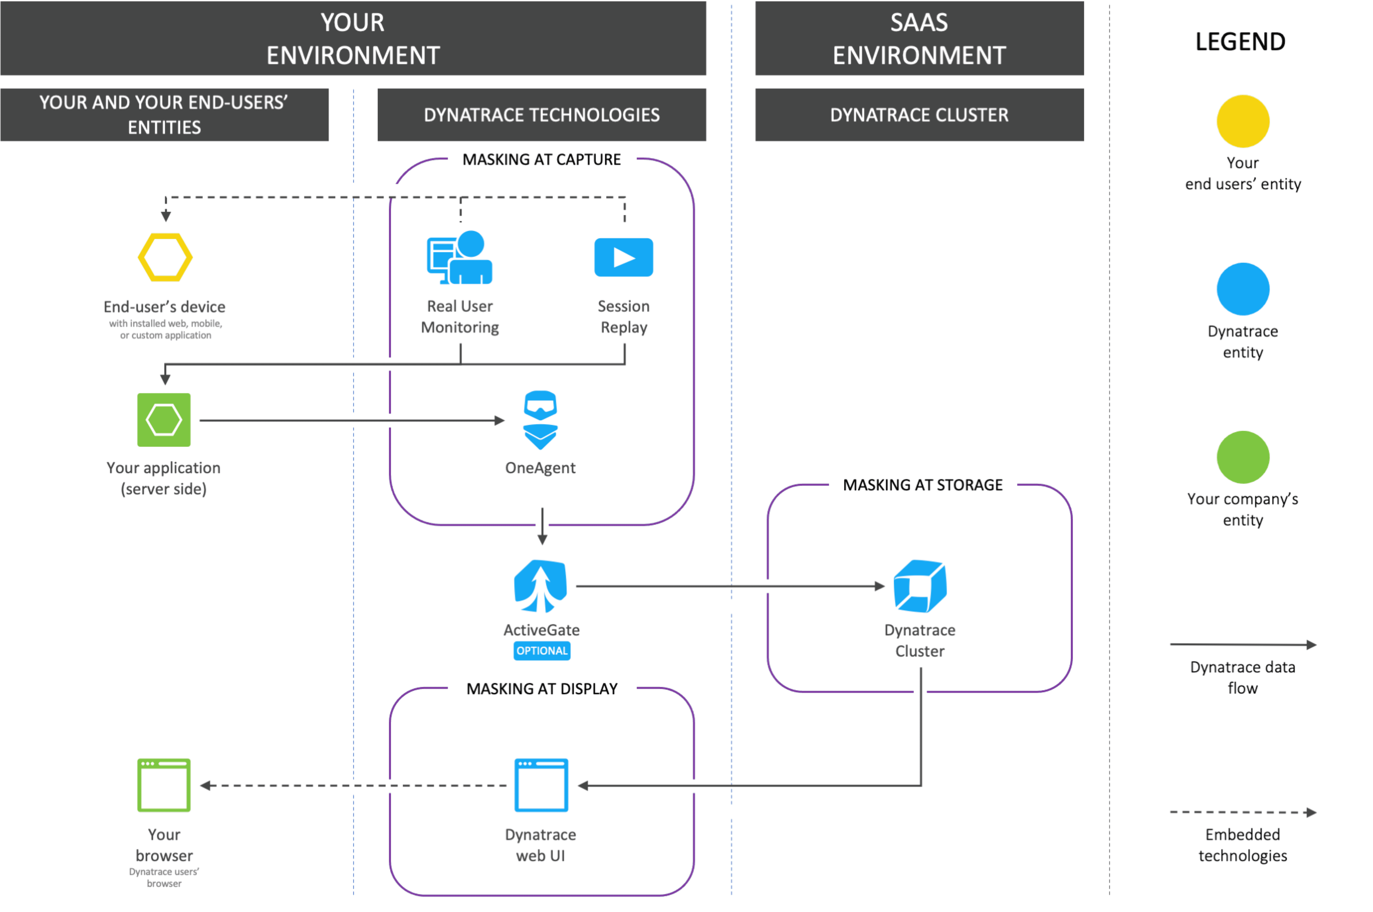

Slide 8
OneAgent Deployment Options
Installation Methods:
Linux shell script
Windows executable (.exe)
Kubernetes operator
Cloud automation (AWS, Azure, GCP)
Ansible automation

Slide 9
Deep Monitoring vs Infrastructure-only
Deep Monitoring:
Code-level tracing
PurePath
Service flow
Database calls
Infrastructure-only:
CPU
Memory
Disk
Network
No code instrumentation

Slide 10
Host Monitoring Overview
Host Monitoring Includes:
CPU utilization
Memory usage
Disk I/O
Network traffic
Process-level metrics
UI Navigation:
Deploy Dynatrace → Hosts → Select Host

Slide 11
Process Monitoring
Auto-discovery includes:
Java processes
IIS worker processes
Apache / Nginx
Databases
Custom applications

